Slide 1
E Placement Management System
Members:
Shubham Chaudhari
Hetal Khachane
Pratik Thakur
Dnyandeep Yadav
Priya Malpani

Slide 2
Index
SDLC model
DFD
Technology Selection

Slide 3
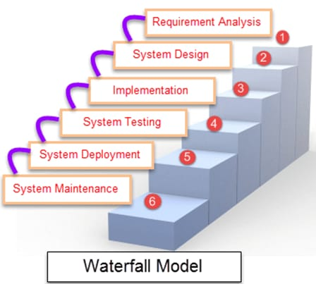
SDLC – Waterfall Model

Slide 4
Stages of Waterfall Model
Feasible study
System design
Implementation
System Testing
System Deployment
System Maintenance

Slide 5
Feasible Study
E- PLACEMENT Management System is a total management and informative system, which provides the up-to date information of all the students in a particular college.
E Placement helps the colleges to overcome the difficulty in keeping records of hundreds and thousands of students and searching for a student eligible for recruitment criteria from the whole thing.
It helps in effective and timely utilization of the hardware and the software resources.

Slide 6
System Design
System Architecture
Data flow diagram
Module
System Layer

Slide 7
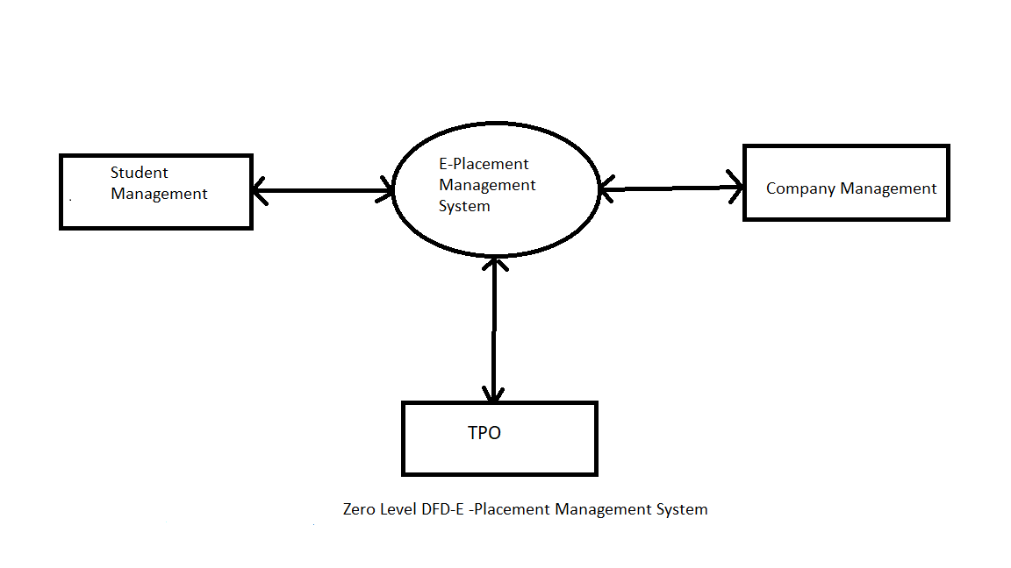
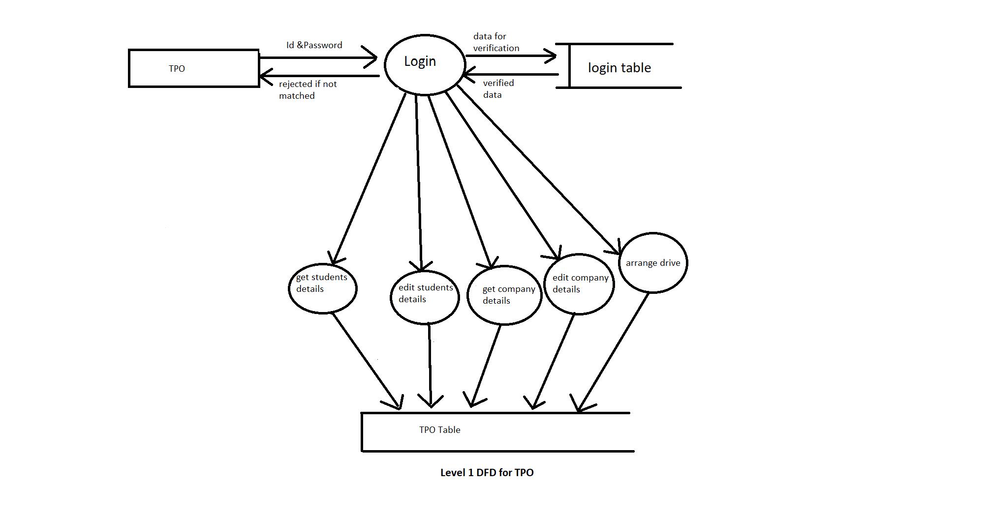
ZERO Level DFD

Slide 8
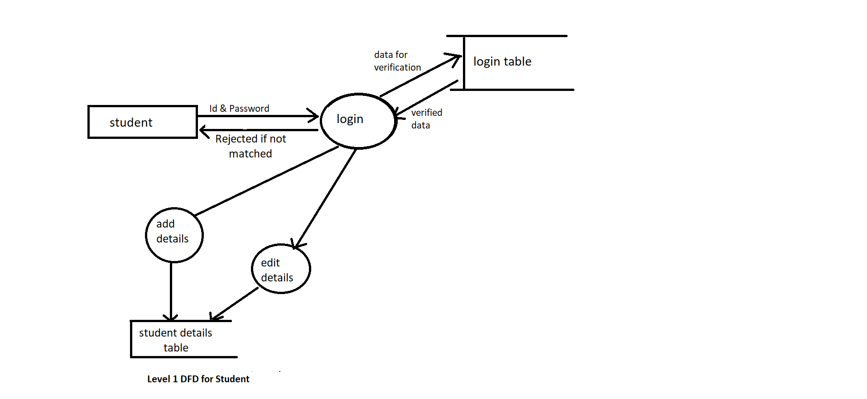
One Level DFD for Student

Slide 9
One Level DFD for TPO

Slide 10
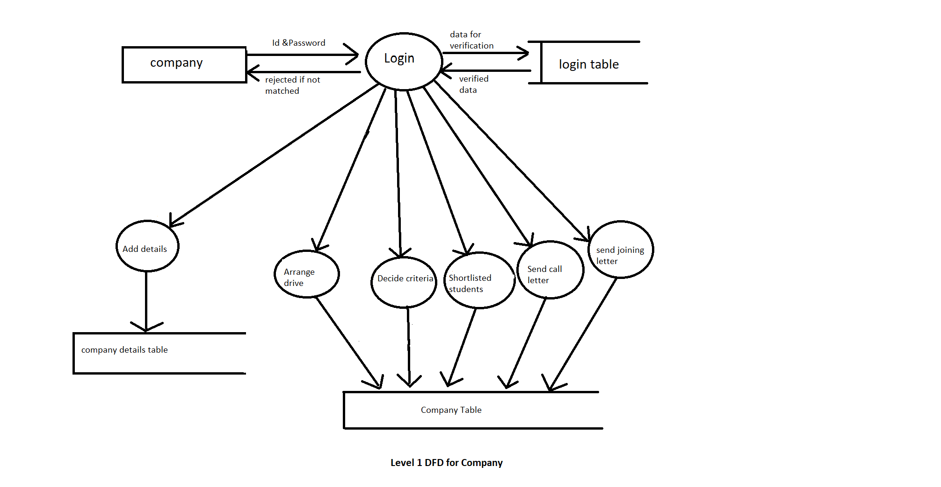
One Level DFD for Company

Slide 11
Modules
TPO
Student
Company

